Slide 1
HOUSING: PRICE PREDICTION
Submitted By:
Neeraj Kumar

Slide 2
Content:-
Overview
Problem Statement
Problem Understanding
What is Housing Price Prediction?
Importance of Housing Price Prediction
Exploratory data analysis
Visualizations
Analysis
Data Cleaning Steps
Model Building
Hyper Parameter Tuning
Saving model & predictions for Best Model
Conclusion.

Slide 3
Overview
In this Presentation we will be looking on the :-
How to analyze the dataset of Housing Price Prediction.
What are EDA steps in cleaning the dataset.
Overall analysis on the problem.
Model building from the train dataset.
Predicting Housing Price for the test dataset.

Slide 4
Problem Statement:-
Our problem is related to one such housing company. A US-based housing company named Surprise Housing has decided to enter the Australian market. The company uses data analytics to purchase houses at a price below their actual values and flip them at a higher price. For the same purpose, the company has collected a data set from the sale of houses in Australia.
The company is looking at prospective properties to buy houses to enter the market. You are required to build a model using Machine Learning in order to predict the actual value of the prospective properties and decide whether to invest in them or not. For this company wants to know:
1) Which variables are important to predict the price of variable?
2) How do these variables describe the price of the house?

Slide 5
Problem Understanding:-
Item 3
Item
Item 2
1
Houses are one of the necessary need of each and every person around the globe and therefore housing and real estate market is one of the markets which is one of the major contributors in the world’s economy.
They can accordingly manipulate the strategy of the firm and concentrate on areas that will yield high returns.
Data science comes as a very important tool to solve problems in the domain to help the companies increase their overall revenue, profits, improving their marketing strategies and focusing on changing trends in house sales and purchases.
It is a very large market and there are various companies working in the domain.
We are required to model the price of houses with the available independent variables. This model will then be used by the management to understand how exactly the prices vary with the variables.

Slide 6
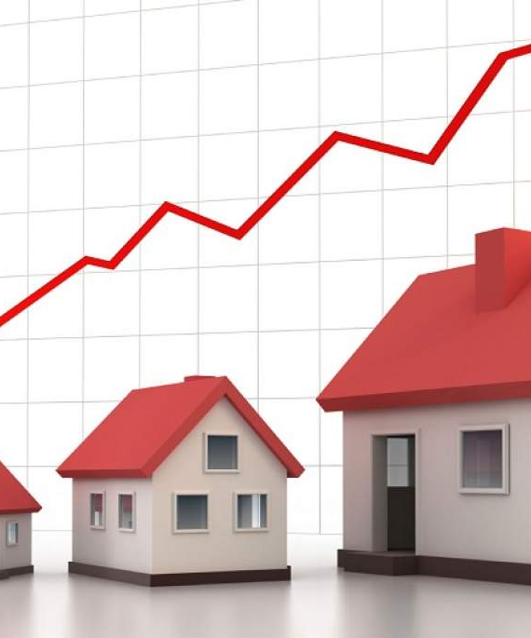
What Is Housing Price Prediction:-
House price prediction can help the developer determine the selling price of a house and can help the customer to arrange the right time to purchase a house. There are three factors that influence the price of a house which include physical conditions, concept and location.

Slide 7

Importance Of Housing Price Prediction:-
House Price prediction, is important to drive Real Estate efficiency. As earlier, House prices were determined by calculating the acquiring and selling price in a locality. Therefore, the House Price prediction model is very essential in filling the information gap and improve Real Estate efficiency

Slide 8
Exploratory Data Analysis:-
As a first step I have imported required libraries and I have imported both the datasets( i.e. Train and Test) which were in csv format.
Then I did all the statistical analysis like checking shape, nunique(unique value each column contains), value counts, info etc.
While checking the info of the datasets I found some columns with more than 80% null values, so these columns will create skewness in datasets so I decided to drop those columns, since it seem to me as unnecessary.
Then while looking into the value counts I found some columns with more than 85% zero values this also creates skewness in the model and there are chances of getting model bias so I have dropped those columns with more than 85% zero values.

Slide 9
Exploratory Data Analysis:-
While checking for null values I found null values in most of the columns and I have used imputation method to replace those null values (mode for categorical column and mean for numerical columns).
In Id and Utilities column the unique counts were 1168 and 1 respectively, which means all the entries in Id column are unique and ID is the identity number given for particular asset and all the entries in Utilities column were same so these two column will not help us in model building. So I decided to drop those columns.
Next as a part of feature extraction I converted all the year columns to there respective age. Thinking that age will help us more than year.
And all these steps were performed to both train and test datasets separately and simultaneously.

Slide 10
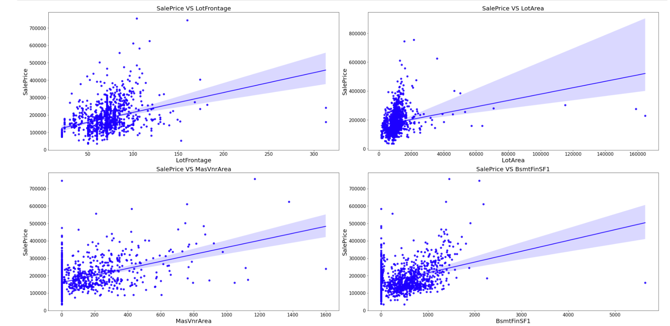
Visualization Of Numerical Column Data:-

Slide 11
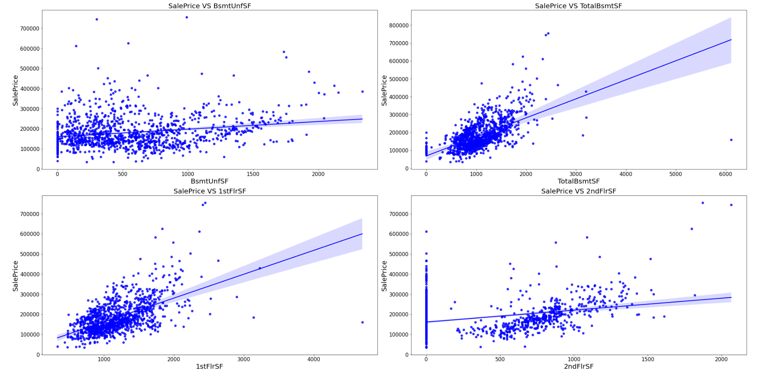
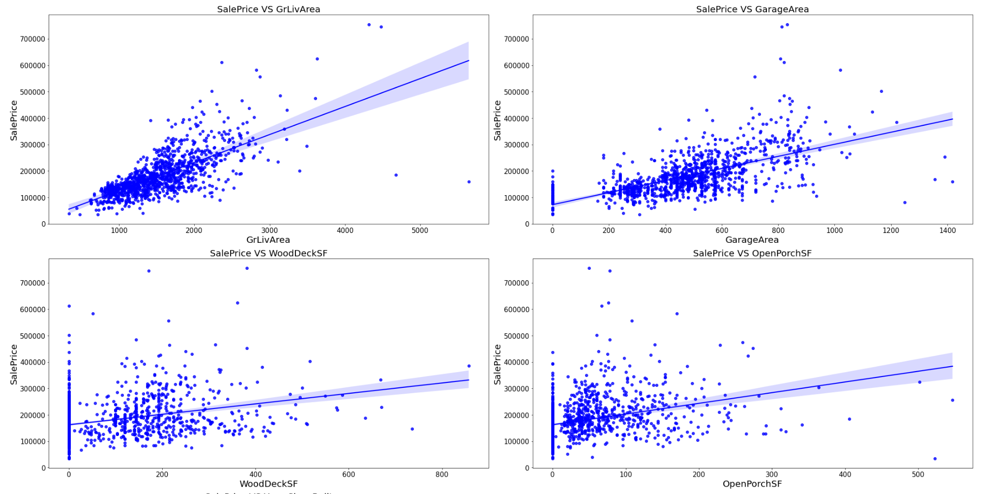
s
Visualization Of Numerical Column Data:-

Slide 12
Observations:
As Linear feet of street connected to property (LotFrontage) is increasing sales is decreasing and the SalePrice is ranging between 0-3 lakhs.
As Lot size in square feet(LotArea) is increasing sales is decreasing and the saleprice is in between 0-4 lakhs.
As Masonry veneer area in square feet(MasVnrArea) is increasing sales is decreasing and saleprice is ranging between 0-4 lakhs.
As Type 1 finished square feet(BsmtFinSF1) is increasing sales is decreasing and the saleprice is in between 0-4 lakhs.
As Unfinished square feet of basement area(BsmtUnfSF) is increasing sales is decreasing and the saleprice is in between 0-4 lakhs. There are some outliers also.
As Total square feet of basement area(TotalBsmtSF) is increasing sales is decreasing and the saleprice is in between 0-4 lakhs.
As First Floor square feet(1stFlrSF) is increseing sales is decreasing and the saleprice is in between 0-4 lakhs.
As Second floor square feet(2ndFlrSF) is increseing sales is increasing in the range 500-1000 and the saleprice is in between 0-4 lakhs.

Slide 13
As Above grade (ground) living area square feet(GrLivArea) is increasing sales is decreasing and the saleprice is in between 0-4 lakhs.
As Size of garage in square feet(GarageArea) is increasing sales is increasing and the saleprice is in between 0-4 lakhs.
As Wood deck area in square feet(WoodDeckSF) is increasing sales is decreasing and the saleprice is in between 0-4 lakhs.
As Open porch area in square feet(OpenPorchSF) is increasing sales is decreasing and the saleprice is in between 0-4 lakhs.
As Year_SinceBuilt is increasing sales is decreasing and the saleprice is high for newly built building and the sales price is in between 0-4 lakhs.
As Since Remodel date (same as construction date if no remodeling or additions)(Year_SinceRemodAdded) is increasing sales is decreasing and the saleprice is in between 1-4 lakhs.
As Since Year garage was built(GarageAge) is increasing sales is decreasing and the saleprice is in between 0-4 lakhs.

Slide 14
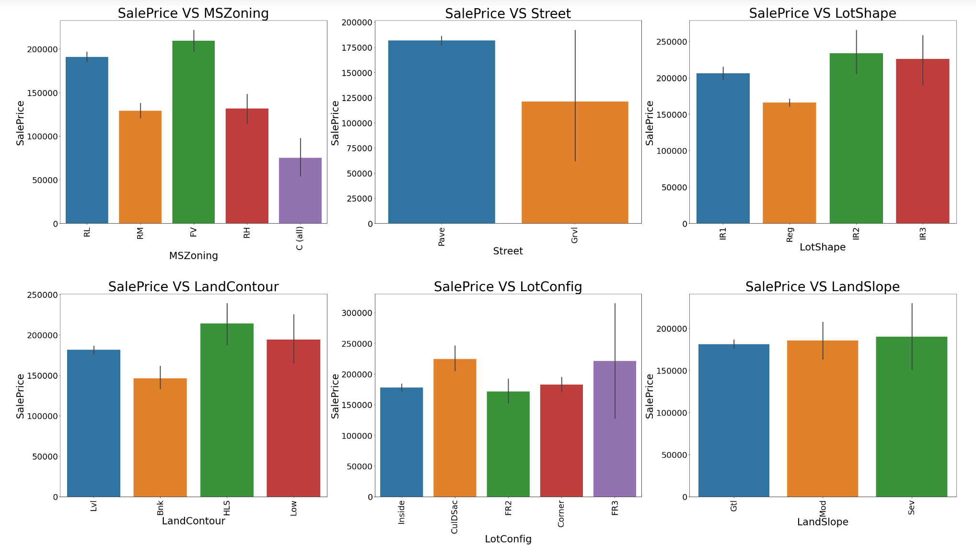
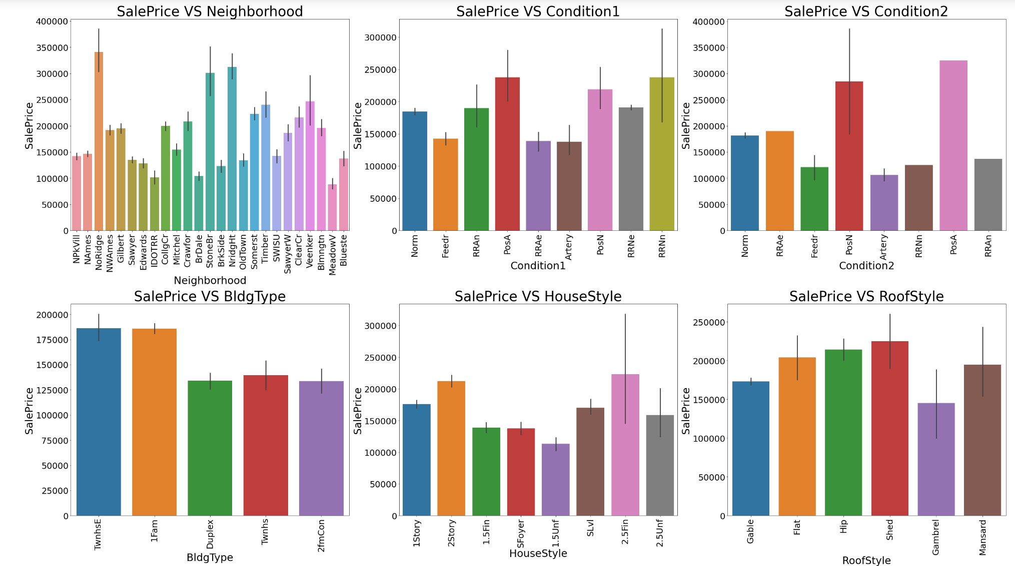
Visualization Of Categorical Column:-

Slide 15
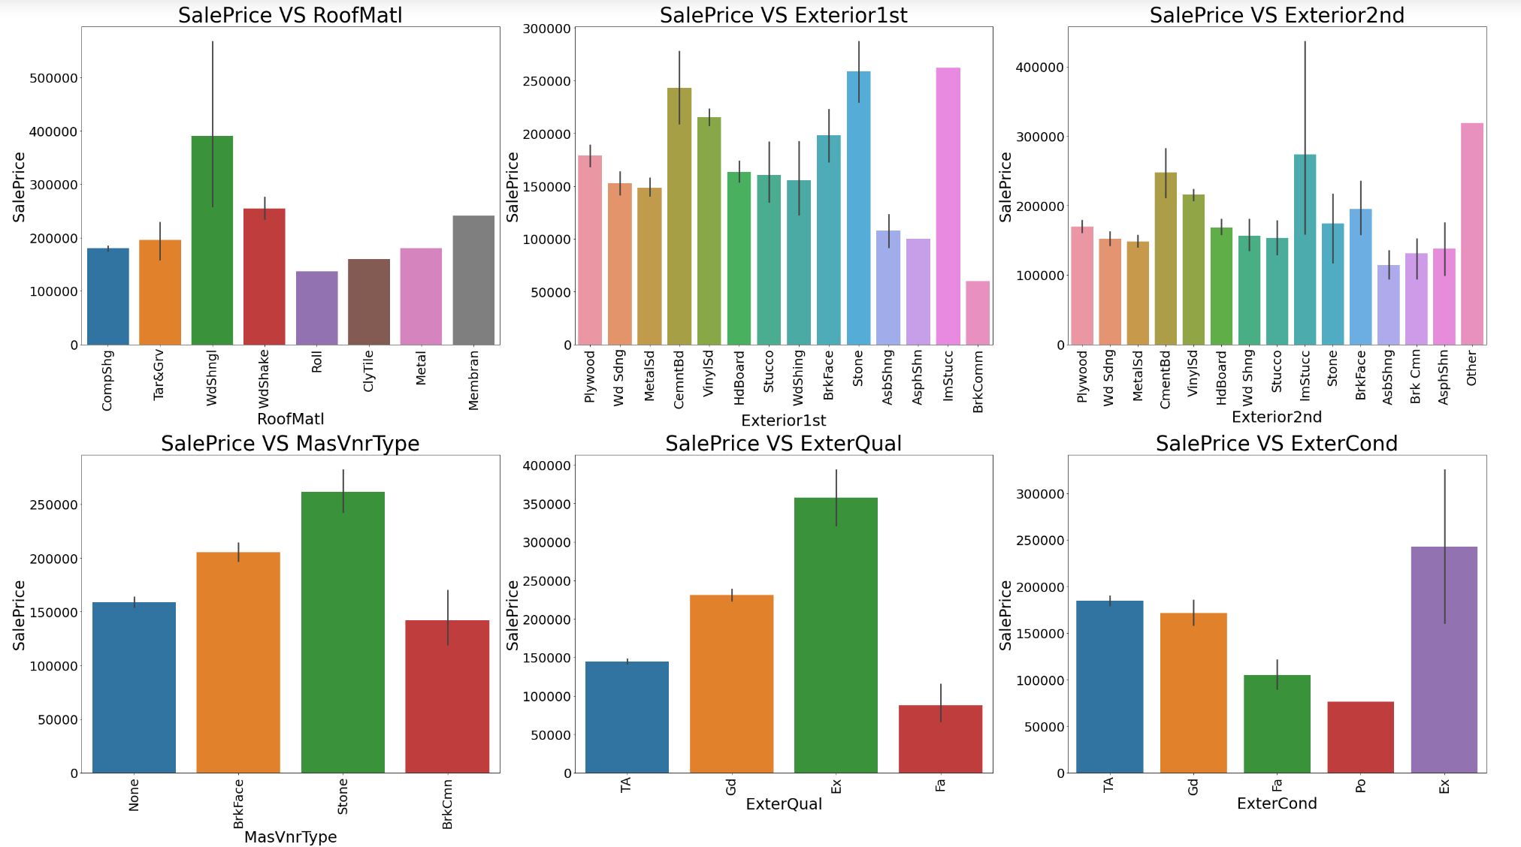
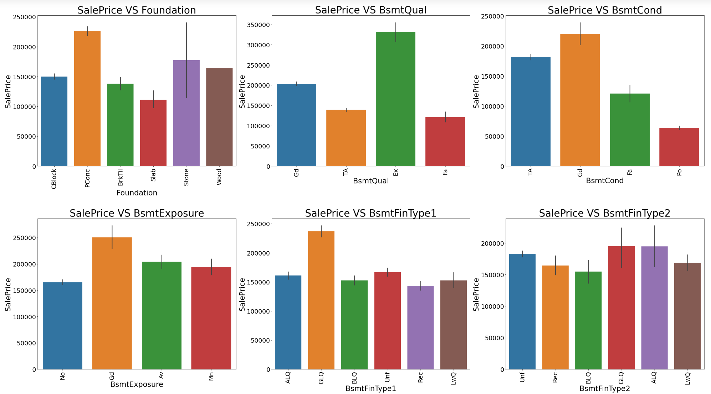
Visualization Of Categorical Column:-

Slide 16
Observations:-
For Floating Village Residential(FV) and Residential Low Density(RL) zoning classification of the sale(MSZoning) the saleprice is high.
2) For paved type of road access to property(Street) the SalePrice is high.
3) For Slightly irregular(IR1), Moderately Irregular(IR2) and Irregular(IR3) shape of property(LotShape) the SalePrice is high.
4) For Hillside - Significant slope from side to side(HLS) in Flatness of the property(LandContour) the SalePrice is High.
5) For Cul-de-sac(CulDSac) Lot configuration(LotConfig) the SalePrice is High.
6) For all types of Slope of property(LandSlope) i.e.,Gentle slope(Gtl), Moderate Slope(Mod) and Severe Slope(Sev) the SalePrice is Equally High.
7) For Northridge(NoRidge) locations within Ames city limits(Neighborhood) the SalePrice is High.
8) For Within 200' of North-South Railroad(RRNn), Adjacent to postive off-site feature(PosA) and Near positive off-site feature--park, greenbelt, etc.(PosN) Proximity to various conditions(Condition1) has the maximum SalePrice.

Slide 17
Observations:-
For Adjacent to postive off-site feature(PosA) and Near positive off-site feature park, greenbelt, etc. (PosN) Proximity to various conditions (if more than one is present)(Condition2) has maximum SalePrice.
For Single-family Detached(1Fam) and Townhouse End Unit(TwnhsE) type of dwelling(BldgType) the SalePrice is high.
For 2Story and Two and one-half story: 2nd level finished(2.5Fin) Style of dwelling(HouseStyle) the SalePrice is high.
For Shed Type of roof(RoofStyle) the SalePrice is high.
For Wood Shingles(WdShngl) Roof material(RoofMat1) the SalePrice is high.
For Cement Board(CemntBd), Imitation Stucco(ImStucc) and Stone type of Exterior covering on house(Exterior1st) the SalePrice is high.
For Cement Board(CemntBd), Imitation Stucco(ImStucc) and other Exterior covering on house (if more than one material)(Exterior2) has maximum SalePrice.
For Stone Masonry veneer type(MasvnrType) the SalePrice is high.
For Excellent(Ex) quality of the material on the exterior(ExterQual) the SalePrice is high.
For Excellent(Ex) present condition of the material on the exterior(ExterCond) the SalePrice is high.
For Poured Contrete(PConc) Type of foundation(Foundation) the SalePrice is high.
For Excellent(100+ inches)(Ex) height of the basement(BsmtQual) the SalePrice is high.

Slide 18
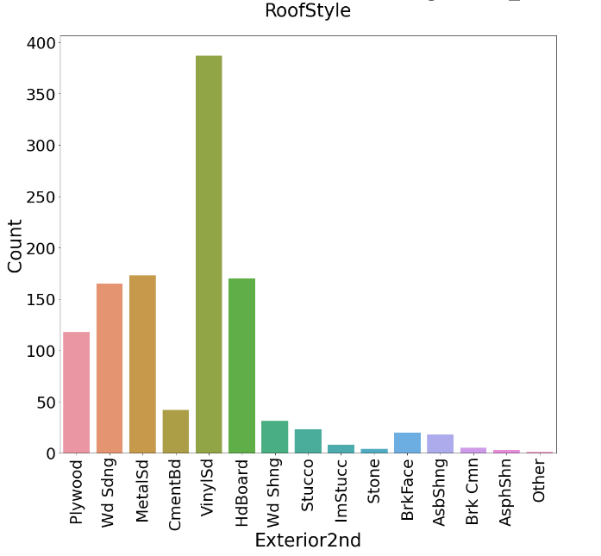
Data Analysis:-
I have used box plot for each pair of categorical features that shows the relation with the median sale price for all the sub categories in each categorical feature.
And also for continuous numerical variables I have used reg plot to show the relationship between continuous numerical variable and target variable.
I found that there is a linear relationship between continuous numerical variable and SalePrice.

Slide 19
Steps Used For Data Cleaning:-
In my datasets I found null values, outliers and also skewness.
I have used imputation method to replace null values. To remove outliers I have used percentile method. And to remove skewness I have used yeo-johnson method.
To encode the categorical columns I have use Ordinal Encoding.
Use of Pearson’s correlation coefficient to check the correlation between dependent and independent features.
Also I have used standardization. Then followed by model building with all regression algorithms.

Slide 20

Model Building:-
Since SalePrice was my target and it was a continuous column so this particular problem was regression problem. And I have used all regression algorithms to build my model.
By looking into the difference of r2 score and cross validation score I found ExtraTreesRegressor as a best model with least difference.
Also to get the best model I have to run through multiple models and to avoid the confusion of overfitting we have go through cross validation.

Slide 21
Below are the list of regression algorithms I have used in my project:-
RandomForestRegressor.
XGBRegressor.
ExtraTreesRegressor.
GradientBoostingRegressor.
DecisionTreeRegressor.

Slide 22
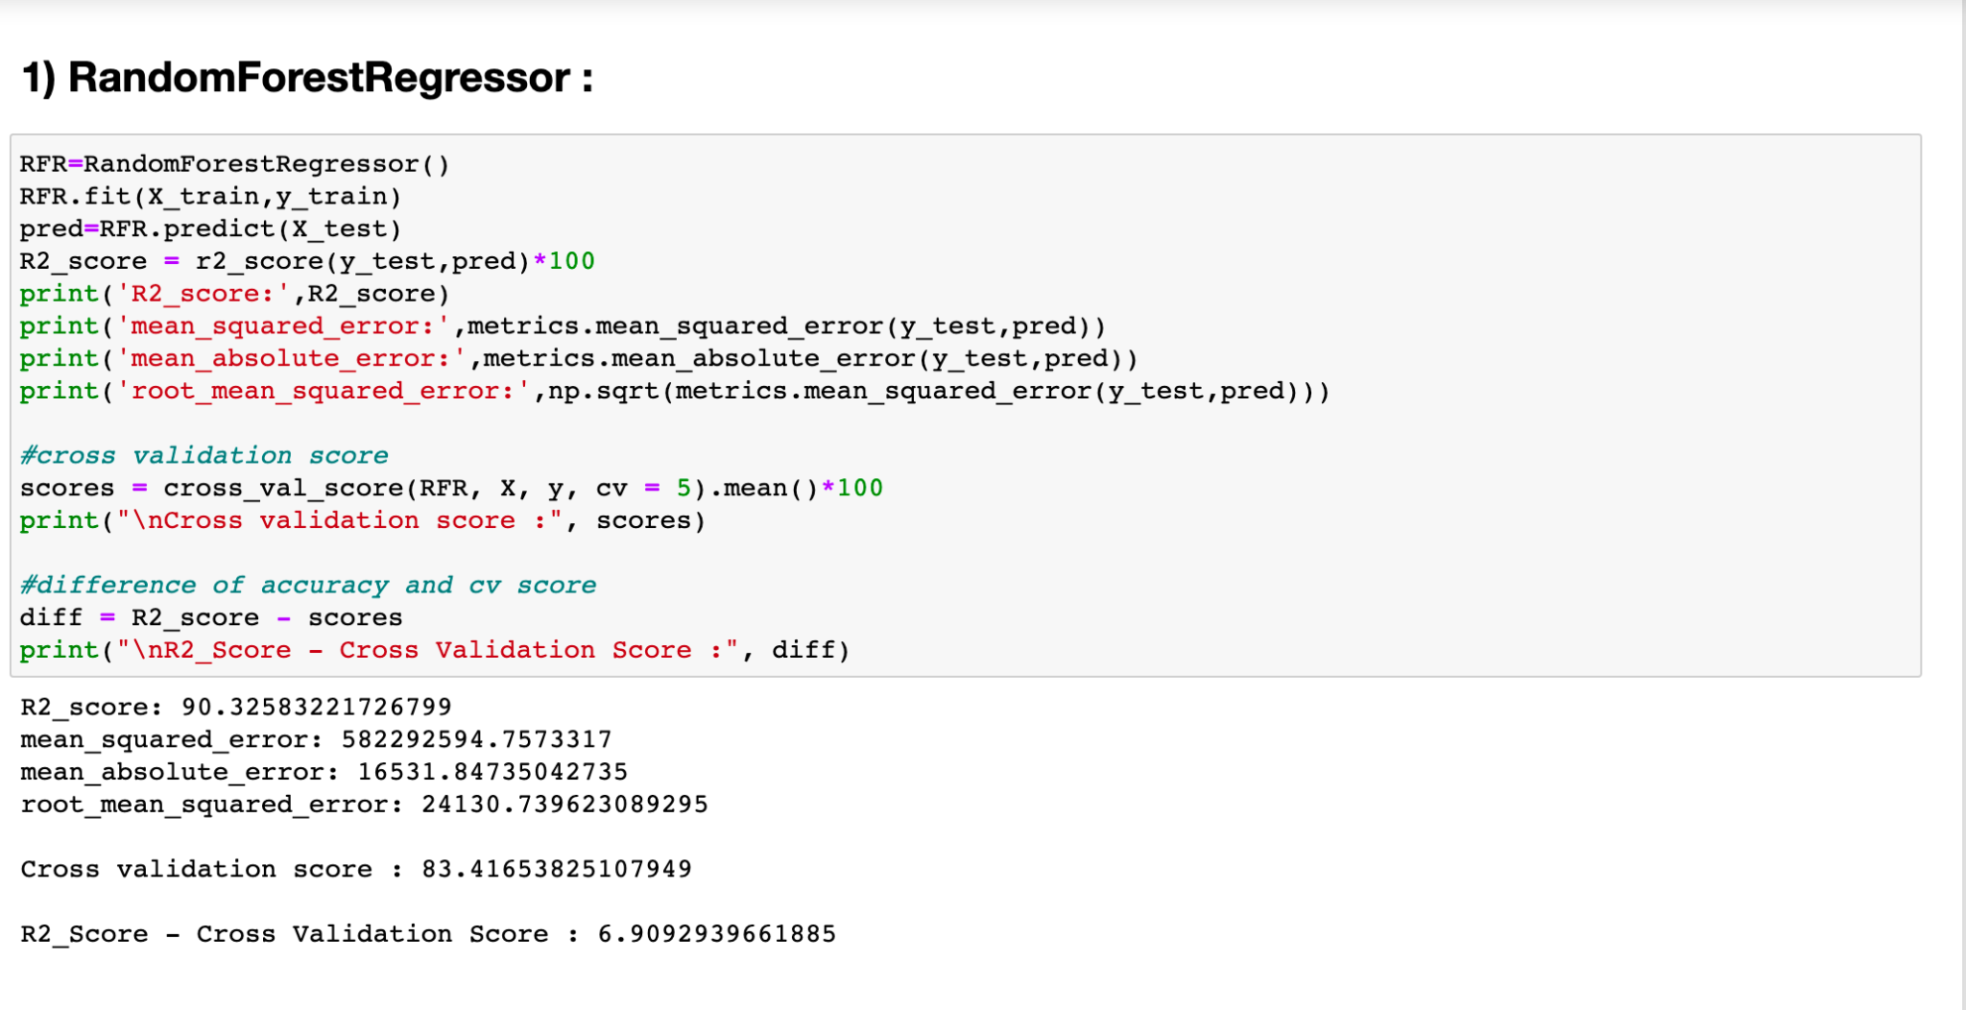
Different Models With Their Performance:-

Slide 23
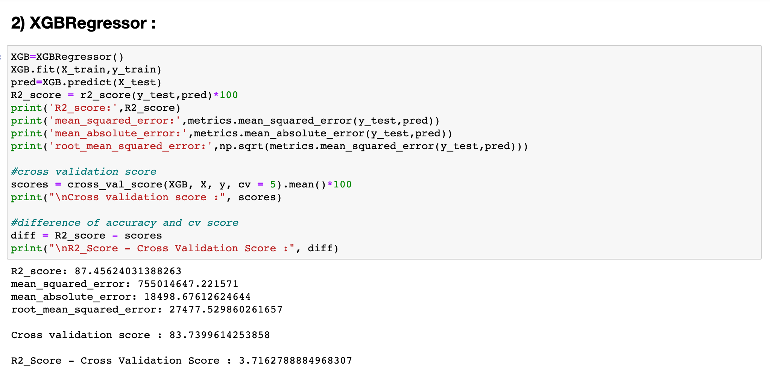
Different Models With Their Performance:-

Slide 24
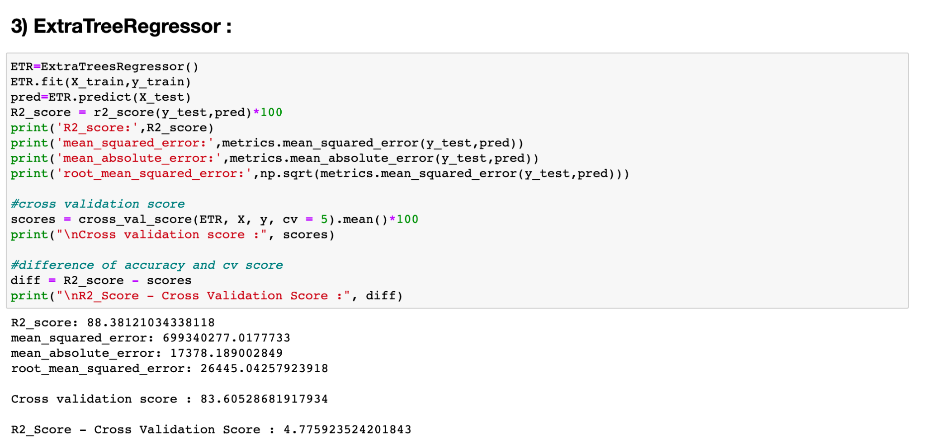
Different Models With Their Performance:-

Slide 25
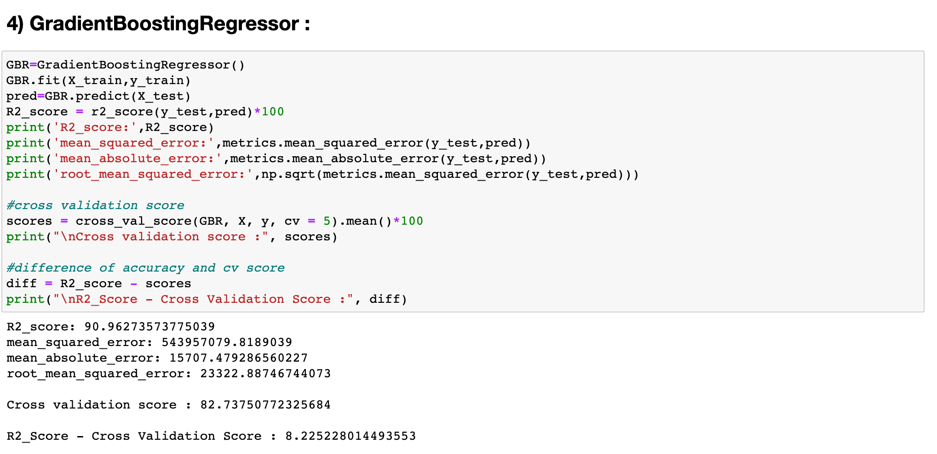
Different Models With Their Performance:-

Slide 26
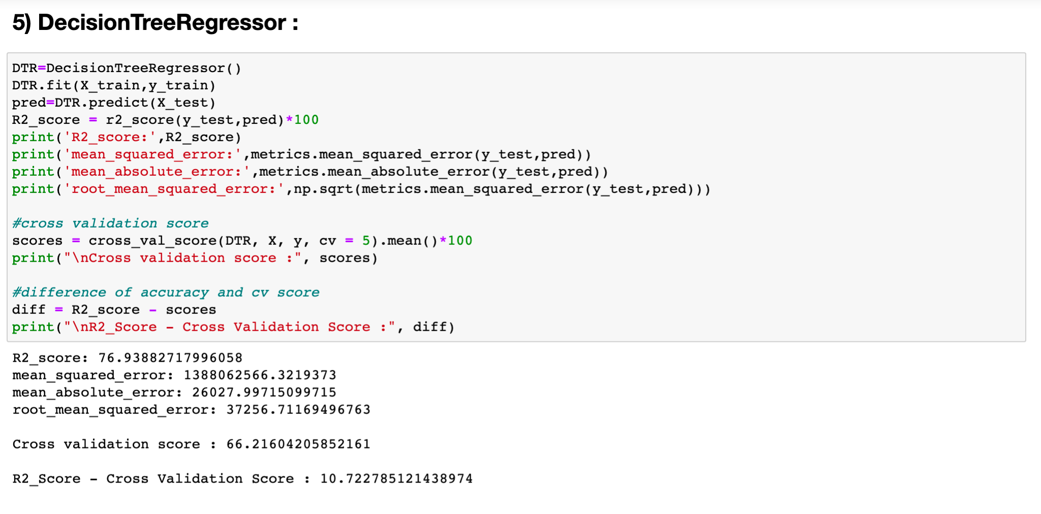
Different Models With Their Performance:-

Slide 27
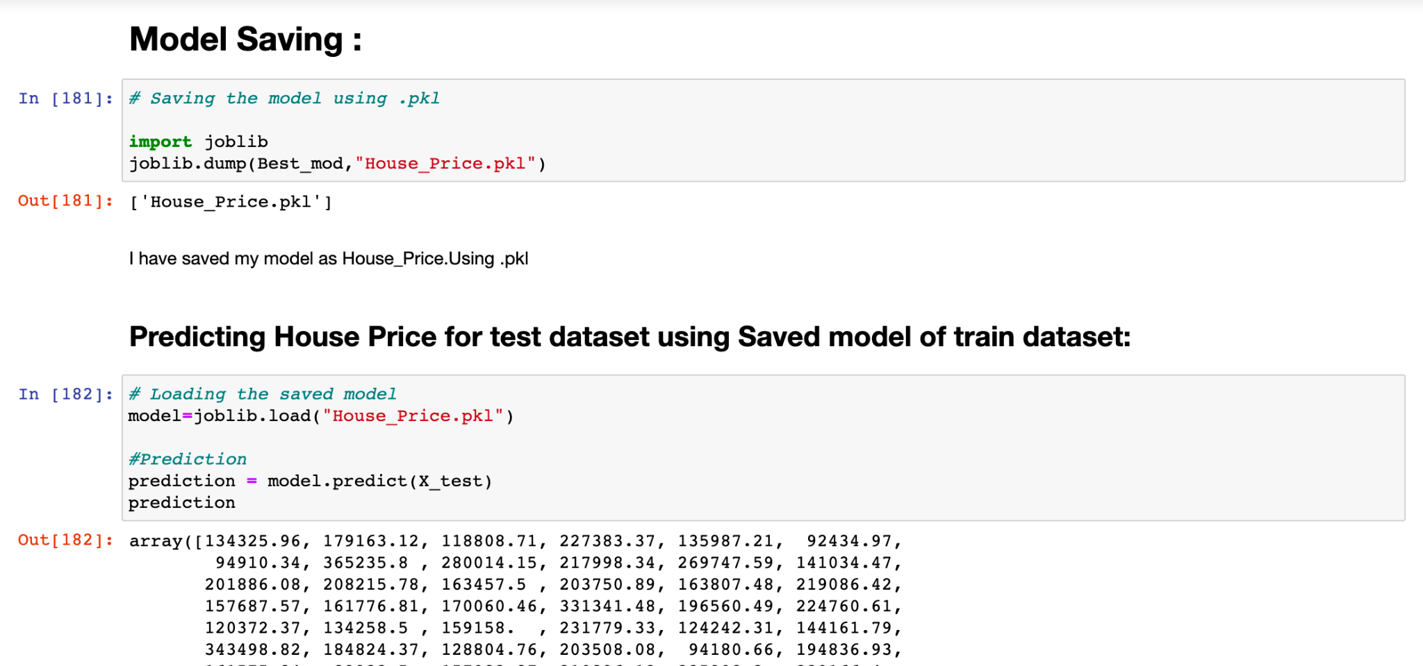
Saving model & predictions for Best Model:-
I have saved my best model using .pkl as follows.
Now after saving the best model, loading my saved model and predicting the test value.

Slide 28
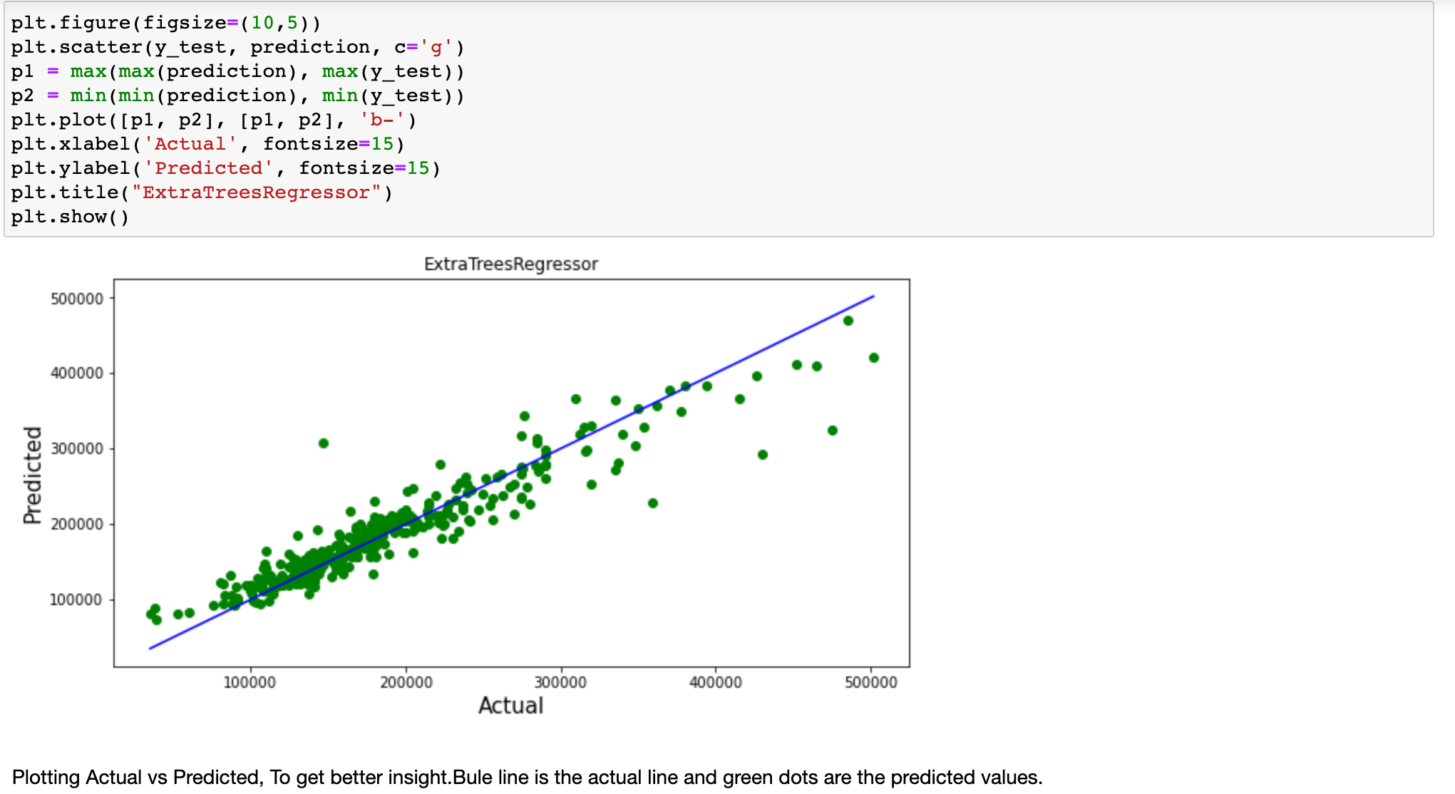
I have predicted the SalePrice for test dataset using saved model of train dataset, and the predictions look good.

Slide 29
Conclusion:-
In this project report, we have used machine learning algorithms to predict the house prices.
We have mentioned the step by step procedure to analyze the dataset and finding the correlation between the features. Thus we can select the features which are not correlated to each other and are independent in nature.
We calculated the performance of each model using different performance metrics and compared them based on these metrics.
There were large no. of feature present in our dataset, I analyse the data and dropped all the necessary feature.
From overall analysis and visualization i come into conclusion that , the feature that most effect the sales price of a property are:
[OverallQual, GrLiveArea, ExterQual, KitchenQual, BsmtQual, GarageCars, GarageArea, TotalBsmtSF, 1stFirSF, FullBath, KitchenAbvGr, GarageFinish, Year_SinceBuilt]
I've increased the accuracy of best fit model(ExtraTree Regressor) using Hyper Parameter Tuning from 88.38 to 88.63, a Model With 88.63 % accuray is quite a good model , and will be a great help in predicting nearly correct prices.

Slide 30
I hope this model will help companies to predict the actual value of the prospective properties and decide whether to invest in them or not.
To conclude, the application of machine learning in property research is still at an early stage. We hope this study has moved a small step ahead in providing some methodological and empirical contributions to property appraisal, and presenting an alternative approach to the valuation of housing prices.
Future direction of research may consider incorporating additional property transaction data from a larger geographical location with more features, or analysing other property types beyond housing development.
Conclusion:-

Slide 31
Thank You

